Slide 1
Health, Well-Being & Adoptee Connections in Adulthood:
MAPPING THE LIFE COURSE OF ADOPTION PROJECT (MAP)
Hollee A. McGinnis, PhD, MSW
Assistant Professor, Virginia Commonwealth University School of Social Work
National Center on Adoption and Permanency (NCAP) Senior Research Fellow
April 21, 2023 | NCAP Webinar Series

Slide 2
Welcome
Discuss goals of a national study “Mapping the Life Course of Adoption Project” (MAP) exploring adult outcomes (physical health, mental health, identity, and well-being) and the nature of adoptee-led groups/ spaced and among adoptees (18+) in the USA
Research Partners: Dr. Amanda Baden (Montclair State University); Dr. JaeRan Kim (University of Washington, Tacoma); Dr. Adam Kim (Wesleyan University); Dr. Gina Samuels (University of Chicago)
Community Partners: Boston Korean Adoptees; International Korean Adoptee Association (IKAA) Network U.S.-based organizations Asian American Adoptees of Washington (AAW), Association of Korean Adoptees-San Francisco, AK Connection (Minnesota), Also-Known-As, Inc. (New York), Korean Adoptees of Chicago (KAtCH )
Funding: Virginia Commonwealth University Presidential Research Quest Fund (PeRQ).

Slide 3
Background and Rationale for the Study
PART I

Slide 4
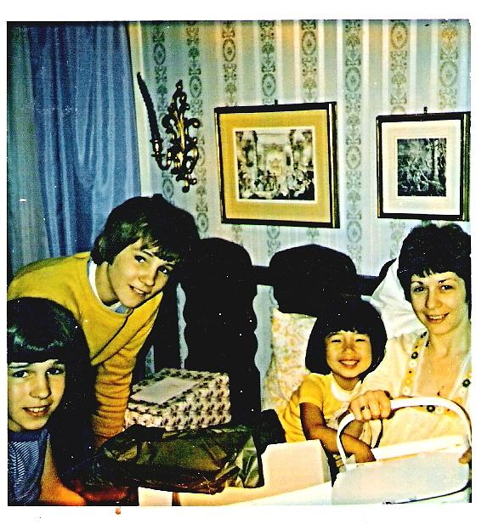
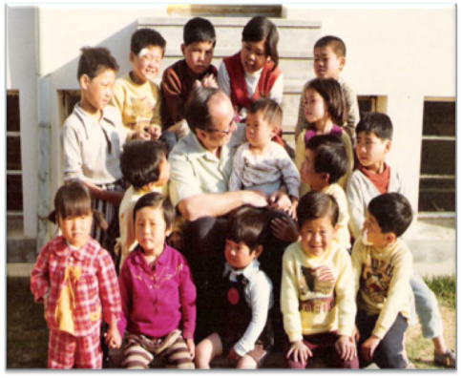
Background: Principle Investigator
1974
1976
Notes:
WHY I CARE ABOUT ADOLESCENTS IN ORPHANAGES AND ADOPTIVE FAMILIES IN KOREA
TRANSITION: But, before I start, I thought I would briefly share with you why I’m so interested in adolescents in orphanages and adoptive families in Korea.
My interest in this area is personal and professional. I was adopted from Korea when I was 3 1⁄2 and grew up in a nice Irish Catholic family in the suburbs of New York City – guess who is me in the photo on the right..
But before I was adopted I lived with my birth parents and was placed in an orphanage for about 6 months before I was adopted. That’s me first row left.
It was in my late adolescence and particularly in college, when I began to actively try to understand the complexities of my life because of my adoption.
This exploration laid the foundation for a non-profit organization I started in 1996 for adult international adoptees in New York City.
The name of the organization – Also-Known-As – speaks to the multiple identities we have but are not apparent on our surface. I am Hollee McGinnis, but I am also-known-As Lee Hwa Yeong, which is my Korean Birth name.
I started the organization to help the next generation of international adoptees and build a community for people whose lives bridge more than one nation, culture and race through adoption.
Through the organization in 2000 I had the opportunity to take a group of adult adoptees on a motherland tour to Korea.
And on that visit I saw my first orphanage – a baby home in Cheonju. Some of the children would cling to me and others seemed to ignore us.
Seeing those children convinced me I had to go back to school and get my master’s in social work because I realized there were much broader issues and that international adoption was just the tip of the iceberg of the larger problem of caring for children without parental care.

Slide 5
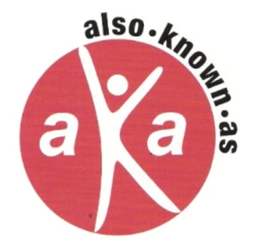
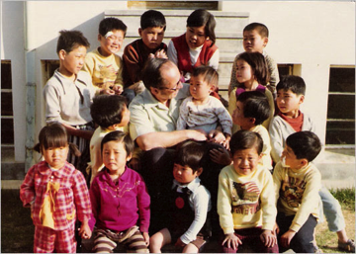
Background: Principle Investigator
Founder, 1996 ⬧ Advisory Board, since 2016
http://www.alsoknownas.org

Slide 6
Korean Adoptee Groups (EU)
1986 - Adopterade Koreaners Forening (Association of Adopted Koreans, AKF )
1991-Korea Klubben
1993-Dongari
1991-Euro-Korean League (EKL)
Notes:
RISE OF ADOPTEE LED ORGANIZATIONS: Our presentation focuses on USA based Korean adoptees but it is important to note that the first Korean adoptee associations were started in Europe. Euro-Korean League was important for founding of GOAL in Korea – we will talk more about that later.

Slide 7
First KoreanAdoptee Groups (USA)
1996-Also-Known-As, Inc. (AKA)
1998-Boston Korean Adoptees, Inc. (BKN)
1994- Association of Korean Adoptees-Southern California (AKA-SoCal)
1996-Asian Adult Adoptees of Washington (AAAW)
McGinnis, H. (2003, Spring). Adult Korean intercountry adoptees: A resource for adoption practice. Columbia University Journal of Student Social Work, 1 (1), 8-14.

Slide 8
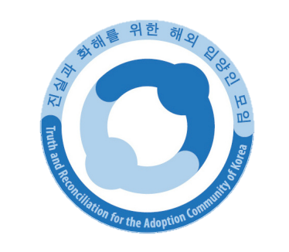
Adoptee Associations in S. Korea
1998-Global Overseas Adoptees’ Link (GOA’L)
2004-Adoptee Solidarity Korea (ASK)
2007-Truth and Reconciliation for the Adoption Community of Korea (TRACK)
Notes:
2004 Gathering also contributed to launch of Activists Groups in Korea

Slide 9
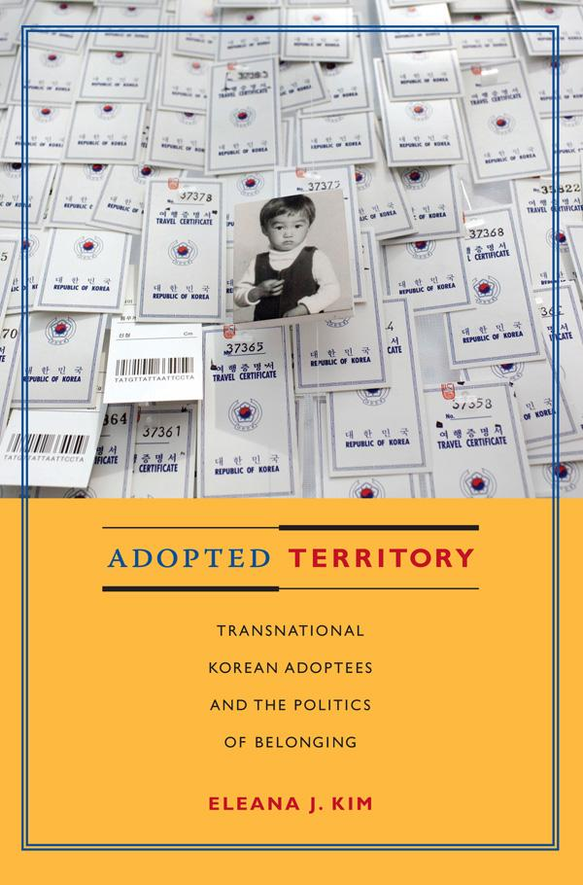
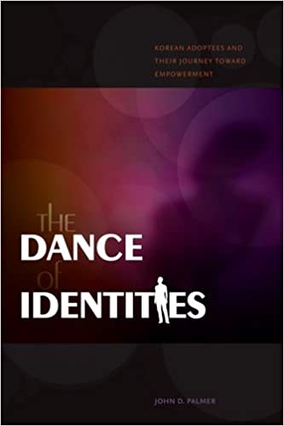
Background: Adoptee Groups
“A History of Korean Adoptees in the USA: Rise of the Adult Korean Adoptee Movement” was first presented with Joy Lieberthal-Rho (Joy.Lrho@gmail.com) at the KAAN Conference, Pittsburgh, PA (June 24, 2016).
Foster Care Alumni / Former foster care youth also began to organize in the 1999 with the formation of Foster Care Alumni of America (https://fostercarealumni.org/)

Slide 10
Early Adult Adoptee Voices
Betty Jean Lifton, 1970s movements.
Motherland Tours: Holt (1973, led by David Kim, non-adoptee)
Culture Camps: Holt (1976, led by Sandy McLaughlin, adoptee)
Adoption Agencies: Holt (1976, Board of Directors, Susan Cox, adoptee)
Notes:
BEFORE THEIR WERE ORGANIZATIONS THERE WERE LONE ADOPTEES INVOLVED IN ADOPTION THROUGH CULTURE CMAPS, MOTHERLAND TOURS AND ADOPTION AGENCIES.
This time line we have: 1980s Culture Camps (Todd gave list and dates of 1st motherlands tours) 1994 SoCal
Put Susan’s picture
Talk about rise of culture camps and how adoptees were influential in establishing them: First culture camps?? Picture of Holt camp logo and year started and other first/ early camps that continue today
Deb Johnson, Mi Ok, Susan Cox – one of the first adoptees to work in an adoption agency? Other early leaders?

Slide 11
Adoptee Leaders: Internet
Also-Known-As’ website
(1996, akaworld.org)
Sunny Jo Korean Adoptees Worldwide (electronic mailing list 1,000 members)
Harlow’s Monkey (Jae Ran Kim)
(adoptee blogger)
Land of Gazillion Adoptees
IamAdoptee.com
Social Media Influencers!!
Notes:
With the internet adoptee community EXPLODED – connections sought for Gathering were transplated or expontial grew with the internet
No longer had travel to a gathering to share a common narrative
Helped with information sharing

Slide 12
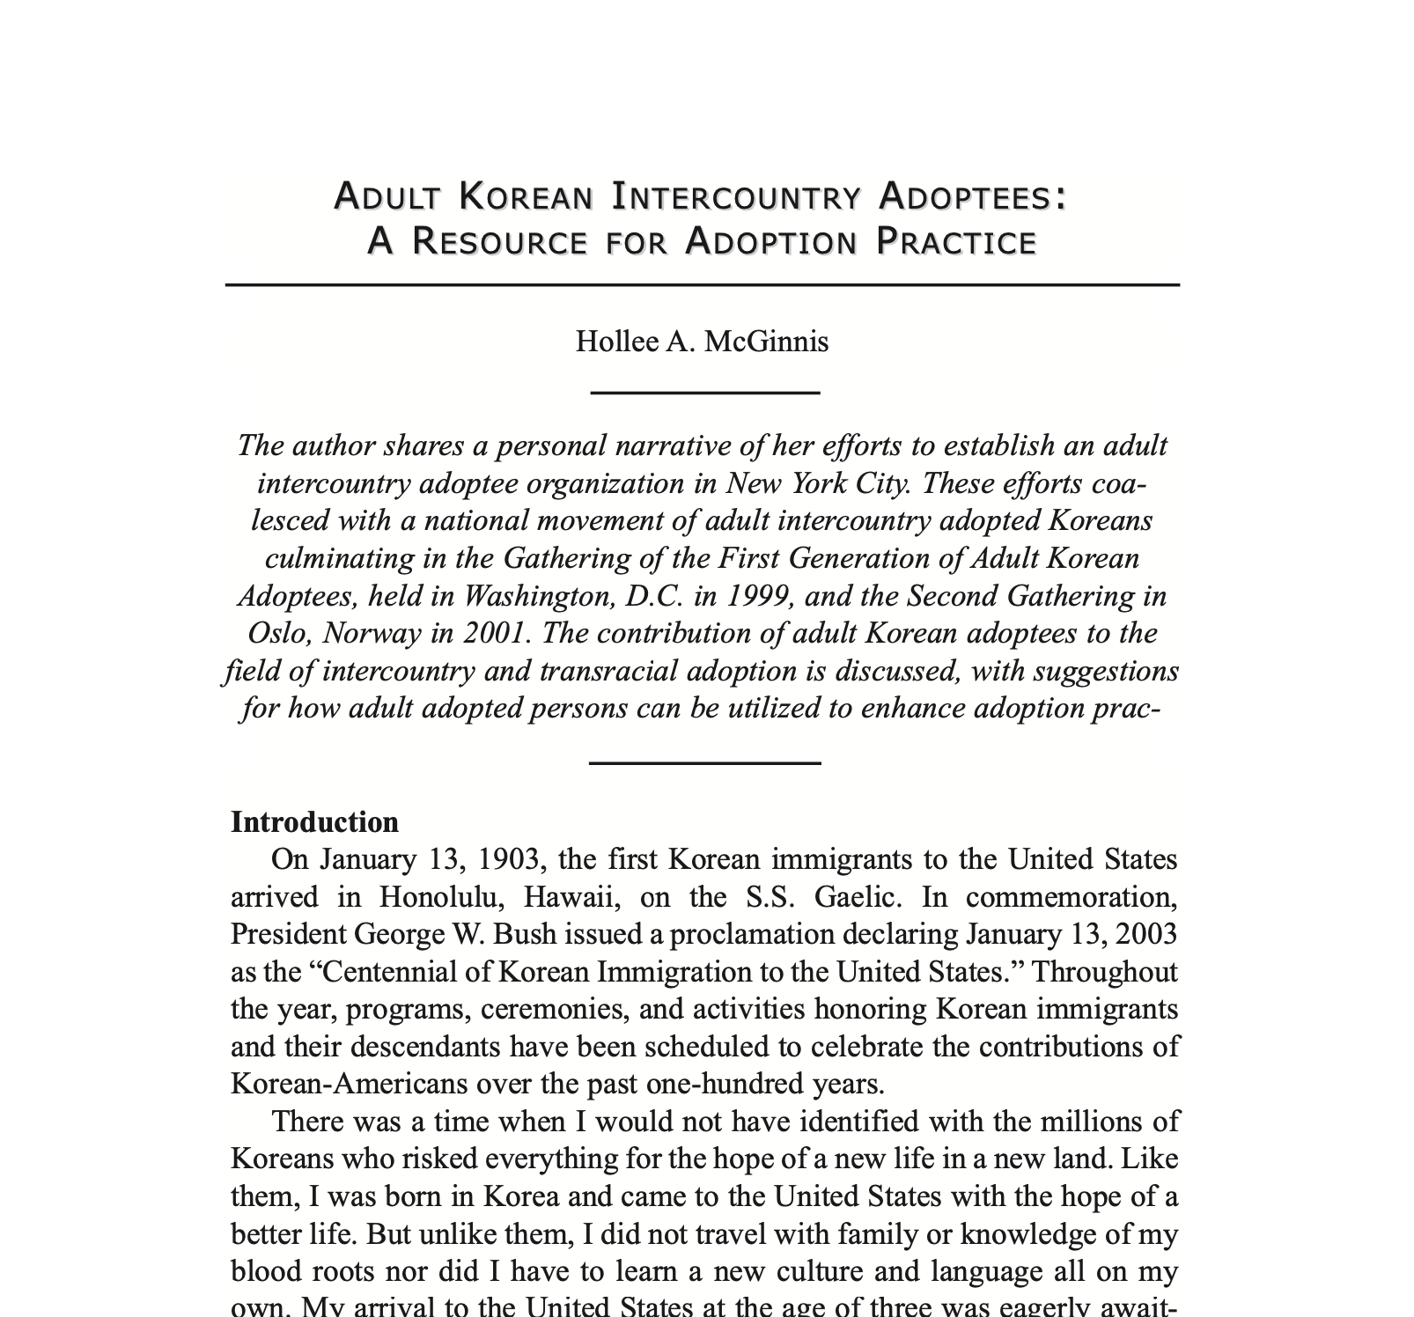
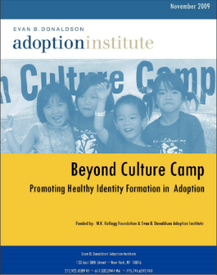
Background: Groups & Identity
McGinnis, H. (2003). Adult Korean Intercountry Adoptees: A Resource for Adoption Practice. Columbia Social Work Review, 1(1), 8-14.
Policy Director (2004-2009)
Notes:
Grounded in Children’s Mental Health through clinical training at Yale Child study Center
Interest in empirically supported interventions to address mental health
Grounded in Chilld Welfare domestically with a focus on permanency and adoption and policy
Issues affected permanency
Focus on child well-being related to adoption specific factors and

Slide 13
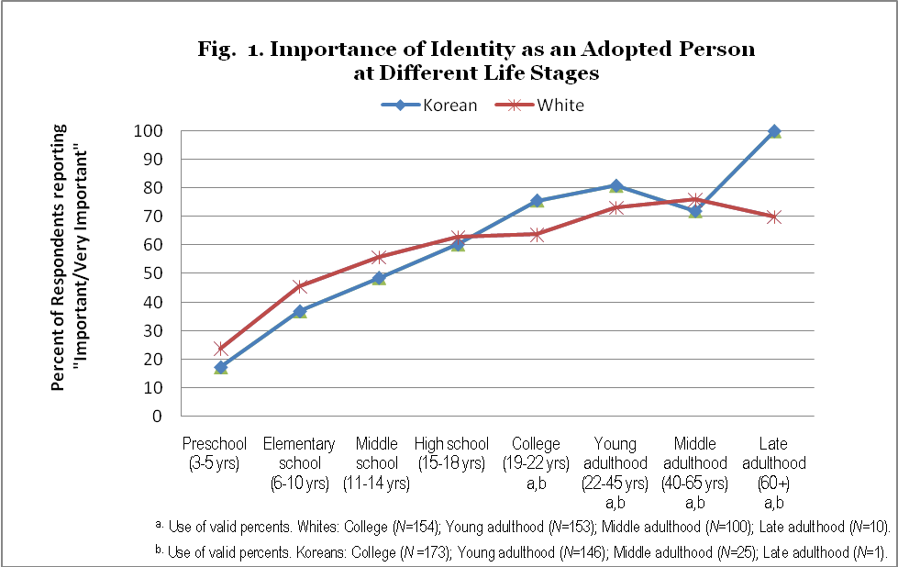
Adoptive identity over the life course
McGinnis, H., Smith, S., Ryan, S., Howard, J. (2009). Monograph. Beyond Culture Camp: Promoting Healthy Identity Formation in Adoption. New York, NY: Donaldson Adoption Institute.
Notes:
TRANSITION: So I just want to briefly show some prior research I conducted to support the increasing salience of adoption with age.
This was a study I conducted of a national sample of adopted adults in the U.S.
Roughly half of respondents were born in South Korea and adopted by two White parents (N=179) and half were White respondents born in the U.S. and adopted by two white parents (N=156). .
The importance of adoption as an identity – that is understanding why a person was placed outside of the care of their biological family – clearly increases with age.
For White adoptees – who are most similar to Korean children adopted into Korean families in that they look racially similar to their adoptive parents –being adopted is more important than for the transracial Korean adoptees at earlier ages.
But for both groups entering elementary school nearly half of White adoptees indicate adoption became more important to them.
By middle school, half of Korean (49%) and White (56%) respondents indicated their adoptive identity had become “important/very important” to them, and about 60 percent from both groups indicated their adoptive identity had become important by high school.

Slide 14
Study Background: Groups & Identity (McGinnis et al., 2009)
 | Korean Adoptees | White Adoptees
Source | N=179 | N=156
Travel to birth country | 74 | 45
Attend racially diverse schools | 73 | 42
Having child care providers, teachers, adult role models same ethnic/race | 73 | 58
Family travel cultural significant places | 72 | 54
Read information from internet | 71 | 62
Live in racially diverse neighborhood | 70 | 53
Books/articles on adoption | 68 | 66
Cook food or dine at restaurants | 68 | 54
Regular contact with people same race/ethnicity | 67 | 51
Exposure to multi-cultural entertainment | 64 | 55
Take classes learn history/culture birth country | 64 | 30
Having siblings | 63 | 68
Events by adult adoptees/ adult adoptee organizations | 63 | 47
Support group for adoptees | 62 | 50
Involve ethnically diverse religious, social groups/activities | 62 | 40
Culture camp | 61 | 15
Study birth language | 59 | 43
Events by same race | 55 | 28
Have traditional objects (dolls etc) from birth country | 49 | 37
Having contact with birth relatives | 47 | 72
Study marital art, traditional dance | 38 | 31
McGinnis, H., Smith, S., Ryan, S., Howard, J. (2009). Monograph. Beyond Culture Camp: Promoting Healthy Identity Formation in Adoption. New York, NY: Donaldson Adoption Institute.

Slide 15
Background: Adult Outcomes
https://www.umass.edu/ruddchair/sites/default/files/rudd.mcginnis.pdf
https://www.umass.edu/ruddchair/virtual-conference-2020-2021

Slide 16
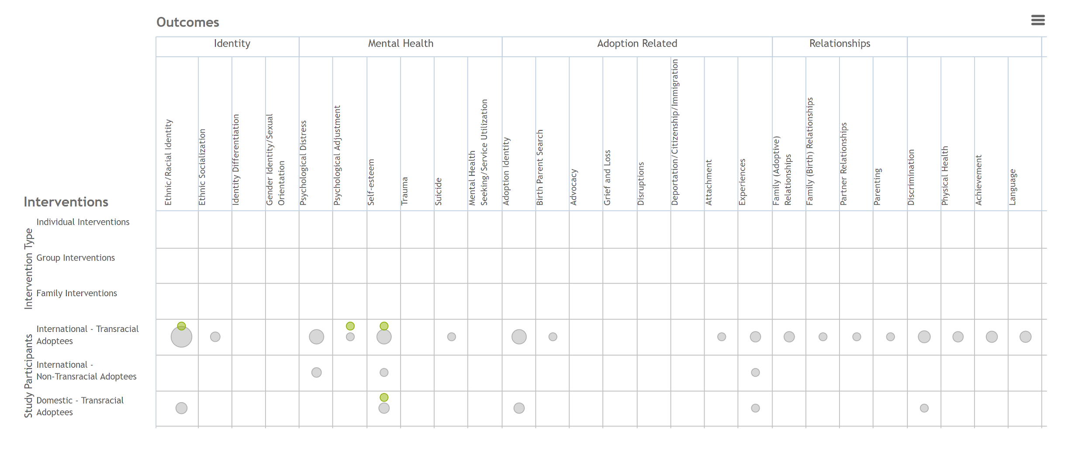
Background: Adult Outcomes
GapMap: Lack of studies on the outcome of transracial & intercountry adoptees in adulthood (McGinnis, H.A., Farina, A., Baden, A., O’Leary-Wiley, M., 2018)

Slide 17
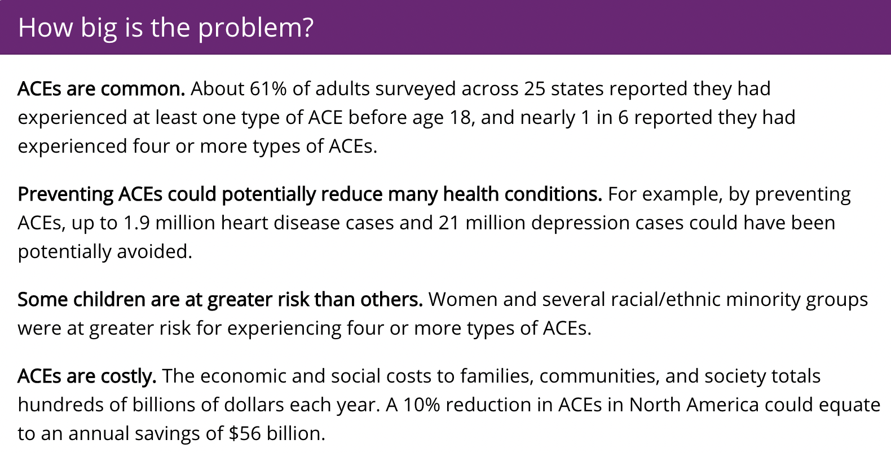
Background: Adult Outcomes
https://www.cdc.gov/violenceprevention/aces/fastfact.html
https://www.ncsl.org/research/health/adverse-childhood-experiences-aces.aspx

Slide 18
Why is community important?
Exploration
Knowledge
Belonging
Power
Change
Notes:
Belonging: “Being the only one”
Exploration: Of our birth culture (camps and trips to Korean) and our adoption (establishing F-4 visas, helping adoptees search for birth family)
Knowledge: about adoption politics, international adoption practices
Power: Strength in numbers which can ultimately lead to
CHANGE: we often disagree how to make this change. Some of us the true change is to stop the practice, for others it is to work within the practice. For others it is to promote the practice.

Slide 19
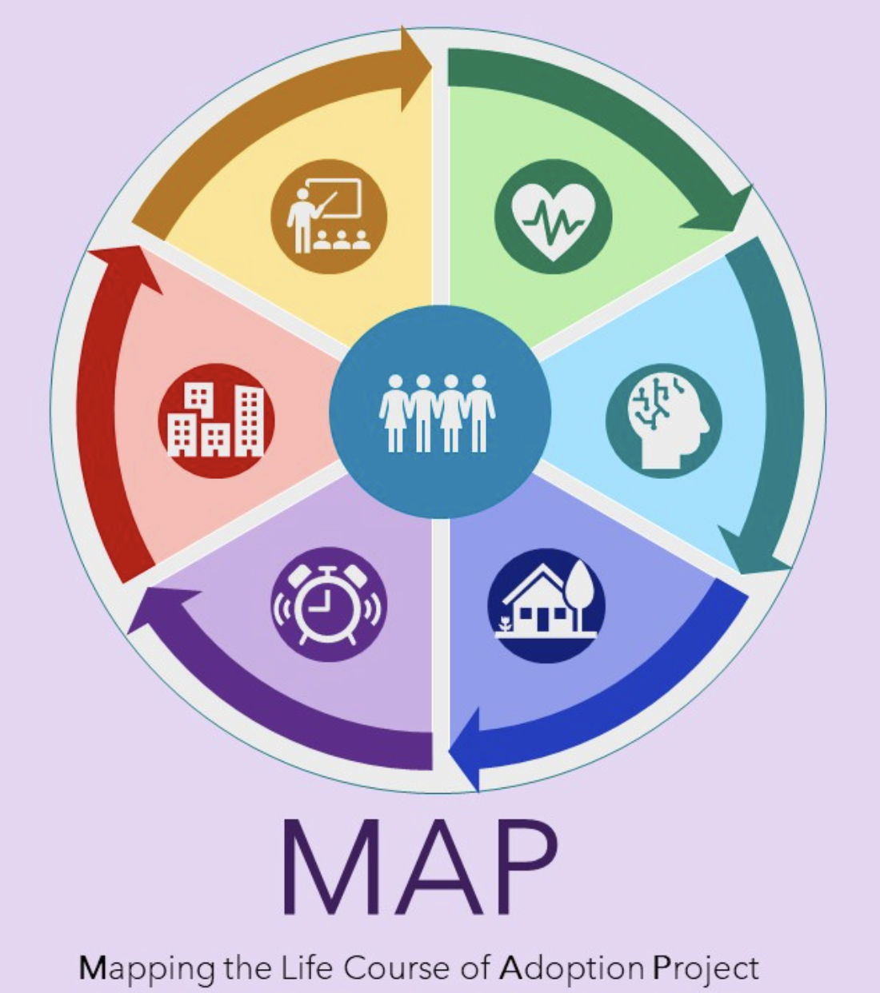
Mapping the life course of Adoption Project (MAP): Health, Well-being & Adoptee Connections in Adulthood
PART II
https://www.caare-research.org/mapproject

Slide 20
MAP Project Goals & Survey Aims
Project Goals:
Collaborative on Adoption & Alternative Care Research (CAARE): https://www.caare-research.org/
To CO-CREATE RESEARCH knowledge and wisdom by and for adoptees:
Adoptee-led: designed by adoptee researchers and adoptee groups
Community-engaged: participants are co-creators of the knowledge at all stages of the study/knowledge creation process
Survey Aims:
Aim 1: Begin to map out the experiences of adoption in adulthood by understanding the physical, mental, identity, and well-being of adopted adults
Aim 2: Begin to explore the nature of adoptee groups/spaces and the role of such connections on thriving adulthoods.

Slide 21
Project Implications
Change practices and policies so children are set up for THRIVING ADULTHOODS
Support for adoptee-led groups as a resource and “intervention” for adoptees in adulthood
Build a community-participatory research agenda for adoptees to learn and grow ~ decolonizing research:
“Research done with us, not to us”

Slide 22
Adult Well-Being & Adoptee Groups Risk & Resilience Perspective (Garmezy, 1973, 1985; Rutter, 1979) Stress & Coping Theory (Lazarus, 1966, 1991; Lazarus & Folkman, 1984; Brodzinsky, 1990)
Risk & Protective Factors
Outcomes
Individual Factors
Current Age, Gender
Child welfare & Adoption history
Mental Health
BSI-18
Complex Trauma Inventory
Participate in Adoptee-led Group Spaces
Cumulative Stress/ Risk Factors
Adverse Childhood Trauma
Lifetime Trauma Exposure
Adult Stressful life events
Racial Discrimination
Adoption Microaggression
Birthparent loss (Birth family thoughts)
Physical Health
Chronic Health
Quality of Life
Identity
Adoptive Identity
Racial/Ethnic Identity
Critical Consciousness
Protective Factors
Benevolent Childhood Experiences
Adult Attachment style
Prosocial Scale
Perceived Social Support

Slide 23
Online Survey Questions – 60 to 90 min; option 1-on-1 follow up interviews
PART I: Background Information
Section 1. Demographics
Section 2. Adoption & Child welfare history
Section 3. Birth Family Thoughts
Section 4. Childhood & Adoptive Family
Section 5. Benevolent Childhood Experiences
PART II: Adoptive Identity & Adoptee Connections
Section 1. Development of Adoptive Identity
Section 2. Participation in Adoptee Groups/ Spaces
Section 3. Adoptive Identity
PART III: Current Information
Section 1. Current Life Information
Section 2. Adult Stressful Life Events
Section 3. Current Quality of Life
Section 4. Current Global Health
Section 5. Chronic Health Problems
Section 6. Current Mental Health
Section 7. General Adult Identity
PART IV: Social Support
Section 1. Prosocial Scale
Section 2. Social Provisions /Social Support
Section 3. Critical Consciousness
PART V: Trauma History
Section 1. Adverse Childhood Experiences (ACEs)
Section 2. Traumatic Life Events Checklist
Section 3. Complex Trauma Symptoms
PART VI: Racial/Ethnic & Adoption Stigma
Section 1. Development Racial/Ethnic Identity
Section 2. Racial/Ethnic Identity
Section 3. Racial/Ethnic Discrimination
Section 4. Adoption Stigma & Microaggressions

Slide 24
How you can get involved!
Complete the survey
Share this PRIVATE Link to the survey with 1 adoptee friend: https://redcap.vcu.edu/surveys/?s=T7D8R9A8CJ4MWEXK
Share this PUBLIC Link (social media, websites, etc.) ofthe survey: https://redcap.vcu.edu/surveys/?s=HJEPXMP8JC98NDPH
Partner in the research! Share the project, engage with the study’s development!!
https://www.caare-research.org/mapproject
Notes:
With the internet adoptee community EXPLODED – connections sought for Gathering were transplated or expontial grew with the internet
No longer had travel to a gathering to share a common narrative
Helped with information sharing

Slide 25
Next Steps: Sharing Findings with the Community - Host a session!
SUMMER 2023
July - Presentation, “The Importance of Community: Preliminary Findings on the Nature of Korean Adoptee Groups & Spaces” at 6th International Korean Adoption Studies Symposium, International Korean Adoptee Associations (IKAA) Gathering, Seoul, S. Korea.
FALL 2023
3 Community webinars with sponsorship from Boston Korean Adoptees Research Program
SPRING 2024
June - Korean American Adoptee Adoptive Parent Network (KAAN) Annual Conference
SUMMER 2024
July 8-12: International Conference on Adoption Research (ICAR), University of Minnesota, Minneapolis, MN
https://www.wearekaan.org/

Slide 26
Thank You!
HAMCGINNIS@VCU.EDU
https://www.linkedin.com/in/hollee-a-mcginnis-msw-phd-ba03114/
https://www.facebook.com/hollee.mcginnis
https://twitter.com/holleemcginnis
https://www.instagram.com/hollee.mcginnis/

Slide 27
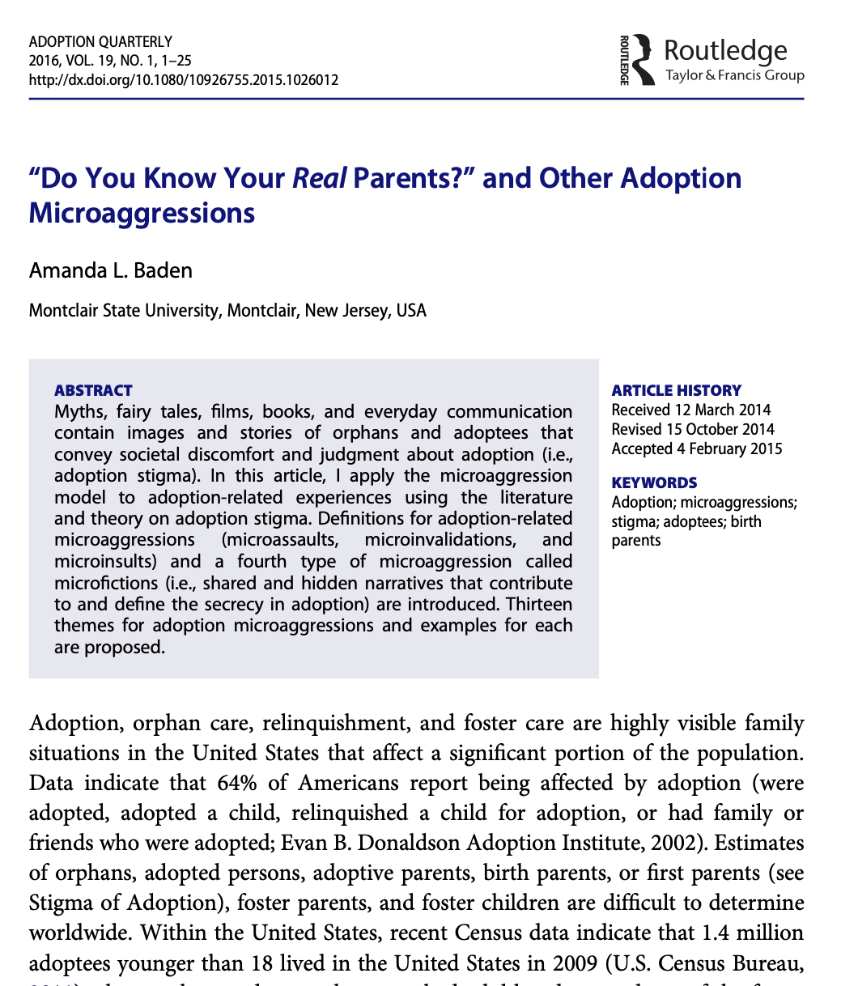
Adoption Microaggressions
Baden, A. L. (2016). “Do you know your real parents?” and other adoption microaggressions. Adoption Quarterly, 19(1), 1-25.

